Slide 1

FINAL ASSESSMENT
Krithiksri Venkatachalam
Employee_id:4369

Slide 2
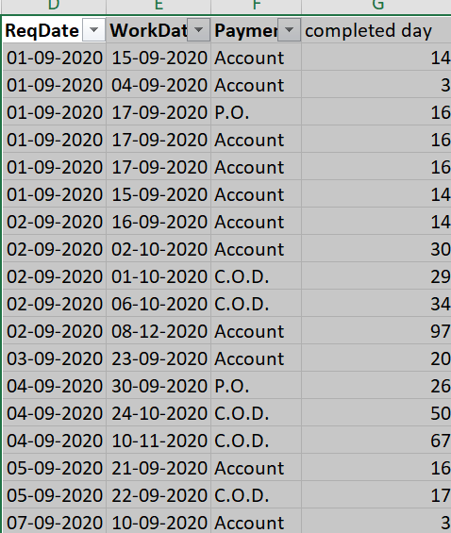

1)Average lead time
Average time calculated from the completed task alone and that is 858 out of 1000 works

Slide 3
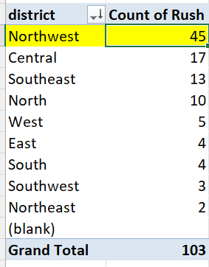
2)Highest district with rush days
North west has the highest number of rush jobs with count of 45.

Slide 4
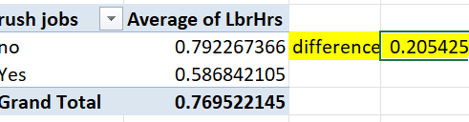
3)Average labour hours
For rush jobs, the average labour hour as 0.58 out of 42 as total rush jobs
The difference in average is 0.205 for rush and non-rush jobs

Slide 5
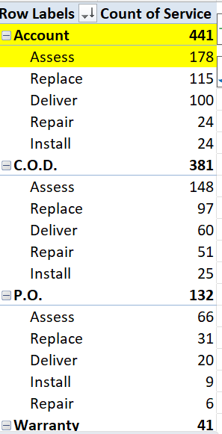
4)Distribution of payment across service
Most preferred payment method is account and service as assess with count of 441 out of 1000

Slide 6
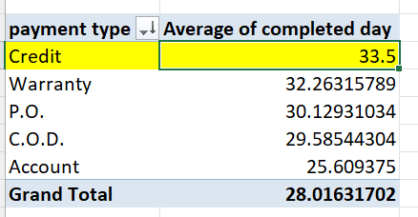
5)Trend in payment type
Out of 1000 work entry only 858 alone completed
For that, if we take average and it show credit payment as frequently used
Yes, the trend in payment type and completed day has long day use account method and less day take credit method

Slide 7
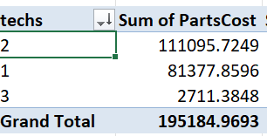
6)Relationship between techs and partscost
Here,if the techs increased then the partscost decreased so,there is a relationship between them

Slide 8
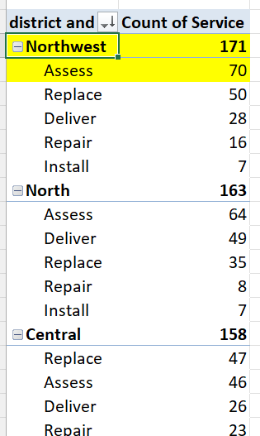
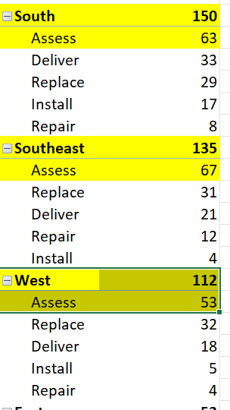
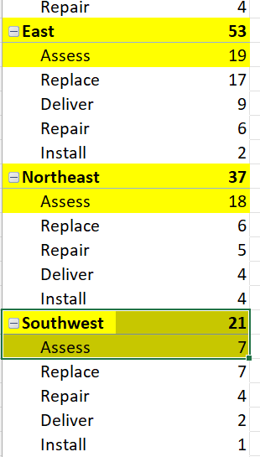
7)Common type of service in each district
Here, 9 district has there most common type of service as assess

Slide 9
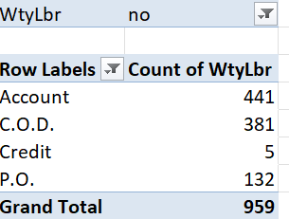
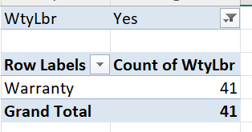
8)Difference in payment and warranty
In work order,with warranty we has 41 data and without has 959 data so there is a significant difference

Slide 10
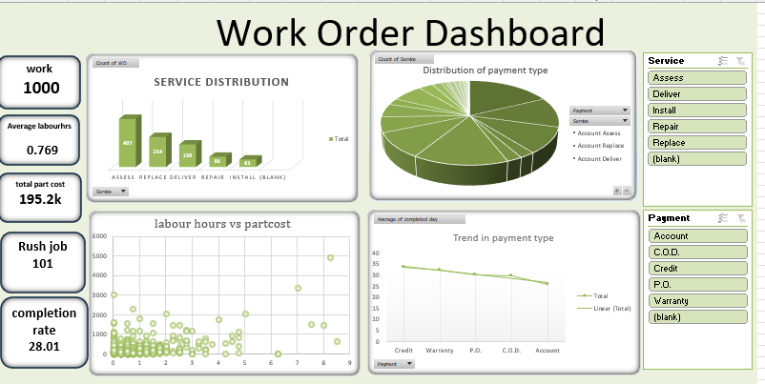
Dashboard

Slide 11
Insights:
Here, service distribution more in assess than others which contribute 50% from the total
Then,in payment and service distribution the accounts and assess play a vital role.
There is a correlation between the labours hours and the partcosts
The trend with the payment type is decreases with more number of techs.

